Slide 1
Residential buildings
This section will introduce the residential building and load models.

Slide 2
Two kinds of models
House E (ETP)
  Class is name is house
  Based on ETP model
  Incorporate mass effects
Appliance models included in module
  Built-in or external load shapes (enduses)
  Physical state based models
NOTE: House A (ASHRAE) is deprecated

Slide 3
House Object
Has two main functions
  Determines state and power consumption of the HVAC system (ETP Model)
  Accumulates effects of residential appliances
Attaches to the power system via a triplex_meter (meter is parent of house)
  If no meter is attached, then defaults to static 120/240 V system
Uses a climate object for weather data

Slide 4
Physical vs. Implicit Models
Only HVAC and waterheater currently incorporate physical models
  Physical models are those that use physical parameters to describe their operation
  Physical models are mainly used in thermostatic operations or other control methods
  Dryer, refrigerator, and freezer in development
Evcharger is a probabilistic model
All other appliances use residential enduse loadshapes – time varying ZIP models

Slide 5
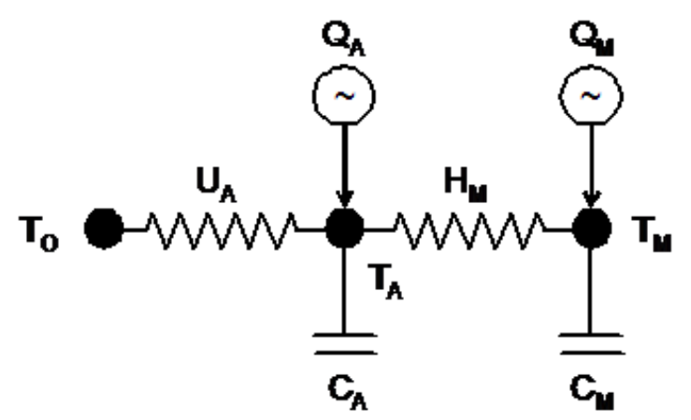
Equivalent Thermal Parameters (ETP)
Two-node lumped-parameter model
Over-damped DC circuit – exponential decay
  Simple enough for direct analytic
  (not numerical) solution & fast computation
  Complex enough to capture building load shapes
  Accounts for weather, building thermal properties,
  solar & internal gains, thermostat settings
  Q is heat added by HVAC system + internal (appliances) + solar
  Internal gains driven by time-of-day, day-of-week schedule
  Solar gains from weather & window properties
  Split between air & mass nodes
Air conditioner & heat pump capacity & COP functions of outdoor temp
  Q_{HVAC-electric} = Capacity_{Thermal} / COP

Slide 6
Heat Balance Equations Solved
Heat balance (conservation of energy) for the air temperature node (T_{A}):
0 = Q_{A} - U_{A} (T_{A} – T_{O}) - H_{M} (T_{A} – T_{M}) - C_{A} dT_{A}/dt
Heat balance for the mass temperature node (T_{M}):
0 = Q_{M} - H_{M} (T_{M} – T_{A}) - C_{M} dT_{M}/dt
Solution is second-order differential equation
  One term for longer mass effects that govern DR, ~hour
  Second term for shorter mass effects governing ~5-min AC cycles
GridLAB-D solves this at every Tstat change-of-state,
& every change in boundary conditions

Slide 7
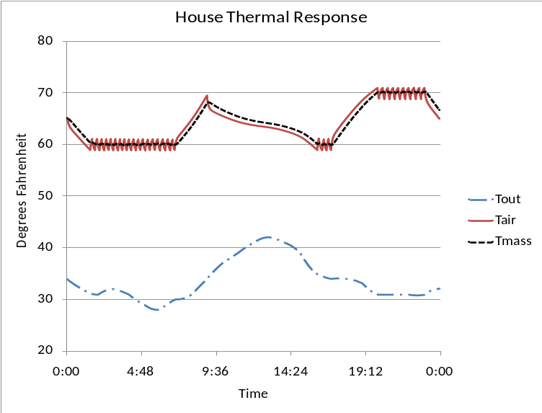
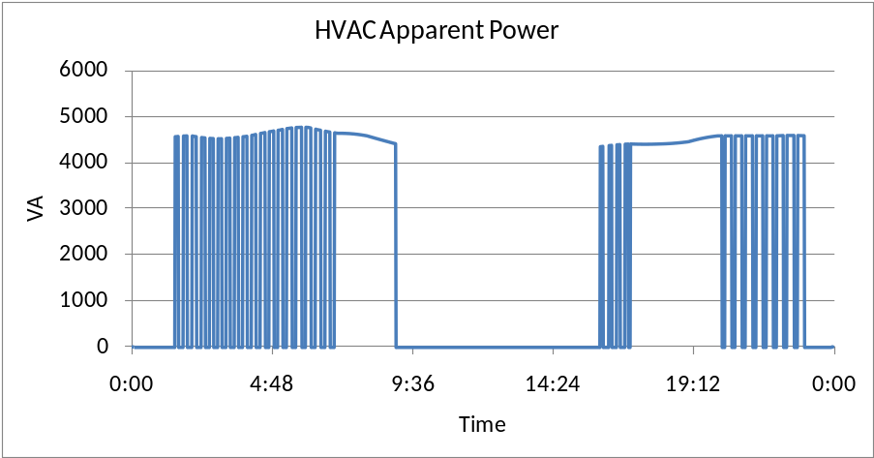
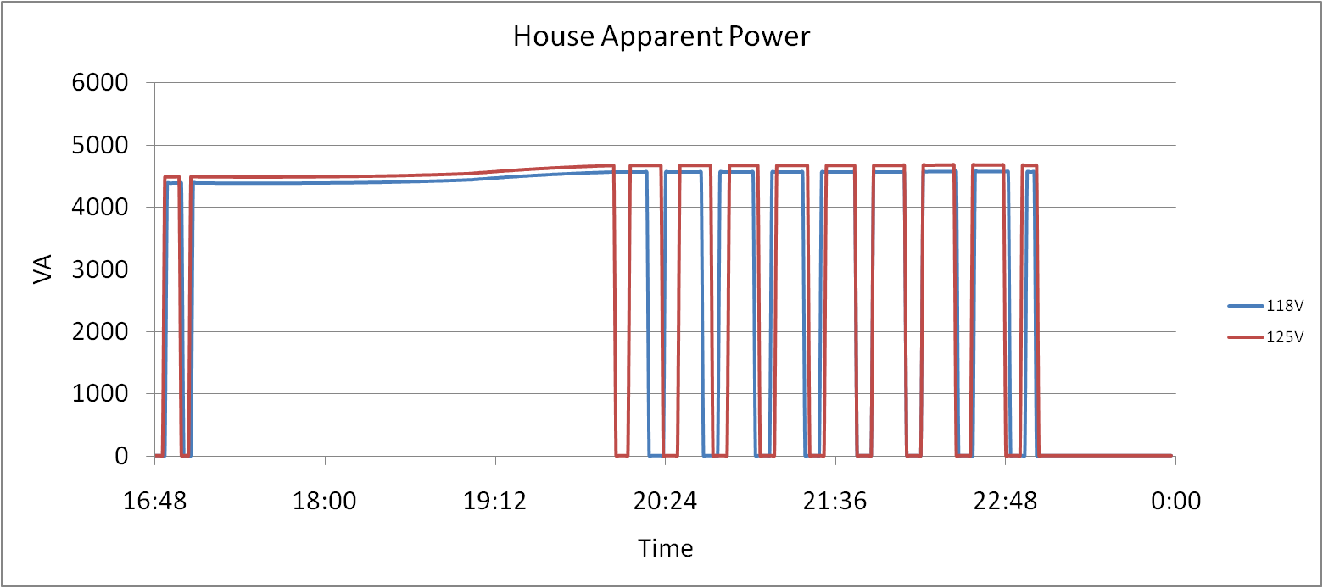
Physical Load Model – Residential HVAC

Slide 8
House design parameters
object house {
// Physical design parameters – all default to ‘reasonable’ values from floor area
double floor_area[sf];
double gross_wall_area[sf];
double ceiling_height[ft];
double aspect_ratio;
double window_wall_ratio;
double number_of_doors;
double exterior_wall_fraction;
double interior_exterior_wall_ratio;
double exterior_ceiling_fraction;
double exterior_floor_fraction;
double number_of_stories;
double Rroof[degF];
double Rwall[degF];
double Rfloor[degF];
double Rwindows[degF];
double Rdoors[degF];
double window_shading;
double window_exterior_transmission_coefficient;
…

Slide 9
HVAC design parameters
object house {
// HVAC design parameters – all default to ‘reasonable’ values from floor area
// Some values are extracted from climate data
double cooling_design_temperature[degF];
double heating_design_temperature[degF];
double design_peak_solar[Btu/h];
double design_internal_gains[W/sf];
double cooling_supply_air_temp[degF];
double heating_supply_air_temp[degF];
double duct_pressure_drop[in];
double heating_COP[pu];
double cooling_COP[Btu/kWh];
double design_heating_capacity[Btu/h];
double design_cooling_capacity[Btu/h];
double design_heating_setpoint[degF];
double design_cooling_setpoint[degF];
double auxiliary_heat_capacity[Btu/h];
double over_sizing_factor[unit];
…

Slide 10
Heatflow parameters
object house {
// These values define the flow of heat from incident solar, air, and mass
double solar_heatgain_factor;
double airchange_per_hour;
double internal_gain[Btu/h];
double solar_gain[Btu/h];
double incident_solar_radiation[Btu/h];
double heat_cool_gain[Btu/h];
double air_heat_fraction[pu];
double mass_heat_capacity[Btu/degF];
double mass_heat_coeff[Btu/degF];
double air_heat_capacity[Btu/degF];
double total_thermal_mass_per_floor_area[Btu/degF];
double interior_surface_heat_transfer_coeff[Btu/h];
double design_internal_gain_density[W/sf];
…

Slide 11
Fan and Motor parameters
object house {
// Fan design parameters – all default to ‘reasonable’ values from HVAC designs
double fan_design_power[W];
double fan_low_power_fraction[pu];
double fan_power[kW];
double fan_design_airflow[cfm];
double fan_impedance_fraction[pu];
double fan_power_fraction[pu];
double fan_current_fraction[pu];
double fan_pow
double hvac_motor_efficiency[unit];
double hvac_motor_loss_power_factor[unit];er_factor[pu];
…

Slide 12
Thermostat parameters
object house {
// These parameters control the operation of the thermostat
double heating_setpoint[degF];
double cooling_setpoint[degF];
double aux_heat_deadband[degF];
double aux_heat_temperature_lockout[degF];
double aux_heat_time_delay[s];
double thermostat_deadband[degF];
int16 thermostat_cycle_time;
timestamp thermostat_last_cycle_time;
int64 last_mode_timer;
…

Slide 13
Derived parameters
object house {
// These parameters are all derived from others, or calculated over time
double air_temperature[degF];
double outdoor_temperature[degF];
double mass_temperature[degF];
double air_volume[cf];
double air_mass[lb];
double latent_load_fraction[pu];
double heating_demand;
double cooling_demand;
double envelope_UA[Btu/degF];
double airchange_UA[Btu/degF];
…

Slide 14
Load parameters
object house {
// These parameters translate appliance operations into electrical demand
enduse panel;
complex panel.energy[kVAh];
complex panel.power[kVA];
complex panel.peak_demand[kVA];
double panel.heatgain[Btu/h];
double panel.heatgain_fraction[pu];
double panel.current_fraction[pu];
double panel.impedance_fraction[pu];
double panel.power_fraction[pu];
double panel.power_factor;
complex panel.constant_power[kVA];
complex panel.constant_current[kVA];
complex panel.constant_admittance[kVA];
double panel.voltage_factor[pu];
double panel.breaker_amps[A];
double hvac_breaker_rating[A];
double hvac_power_factor[unit];
double hvac_load;
double total_load;
…

Slide 15
Enumerations
object house {
// Various enumerations that define different aspects of home, * is default value
enum heating_system_type; //RESISTANCE, *HEAT_PUMP, GAS, NONE
enum cooling_system_type; //HEAT_PUMP, ELECTRIC, *NONE
enum auxiliary_system_type; //ELECTRIC, *NONE
enum auxiliary_strategy; //LOCKOUT, TIMER, DEADBAND, NONE
enum fan_type; //TWO_SPEED, *ONE_SPEED, NONE
enum thermal_integrity_level; //VERY_GOOD, GOOD, ABOVE_NORMAL, NORMAL, BELOW_NORMAL
//LITTLE, VERY_LITTLE, *UNKNOWN
enum glass_type; //*LOW_E_GLASS, GLASS, OTHER
enum window_frame; //INSULATED, WOOD, *THERMAL_BREAK, ALUMINUM, NONE
enum glazing_treatment; //HIGH_S, LOW_S, REFL, ABS, *CLEAR, OTHER
enum glazing_layers; //THREE, *TWO, ONE, OTHER
enum motor_model; //FULL, BASIC, *NONE
enum motor_efficiency; //VERY_GOOD, GOOD, *AVERAGE, POOR, VERY_POOR
…

Slide 16
“Easy” House – Major Parameters
object house {
}
object house {
floor_area 2500;
}
object house {
floor_area 2500;
thermal_integrity GOOD;
cooling_setpoint 72;
heating_setpoint 65;
}
object house {
floor_area 2500;
Rwall 19;
Rroof 30;
Rfloor 22;
Rdoors 5;
Rwindows 2.1;
airchange_per_hour 0.5;
number_of_stories 1;
cooling_setpoint 72;
heating_setpoint 65;
cooling_system_type ELECTRIC;
heating_system_type HEAT_PUMP;
auxiliary_system_type ELECTRIC;
}

Slide 17
Implicit Models
Residential Enduse
All residential objects can be used as a residential enduse
Uses any of four available loadshapes (analog, pulsed, modulated, queued)
Overrides physical state driven models, but certain variables are still used (e.g. placement still determines the where the heatgain goes)
By default, all appliances are turned on as residential enduses
  Certain appliances may be turned on, or all of the turned off
module residential {
implicit_enduses NONE;
or
implicit_enduses LIGHTS|PLUGS;
}

Slide 18
Residential Enduse
object lights {
//User assigned values. Lights are only used as an example.
double power_factor[unit];
double heatgain_fraction[pu];
double installed_power[kW];
double impedance_fraction[pu];
double current_fraction[pu];
double power_fraction[pu];
loadshape shape;
double breaker_amps[A];
//Determined values.
double heatgain[Btu/h];
complex power[kVA];
complex energy[kVAh];
complex peak_demand[kVA];
double voltage_factor[pu];
double constant_current[kVA];
double constant_power[kVA];
double constant_impedance[kVA];
}

Slide 19
Residential Enduse (example)
class lights {
loadshape myshape;
}
object lights {
myshape "type: analog; schedule: schedule-name; energy: value kWh";
installed_power 1 kW;
power_factor 0.95;
impedance_fraction 1.0;
power_fraction 0.0;
current_fraction 0.0;
placement INDOOR;
}

Slide 20
Available Appliances
Waterheater
Lights
Refrigerator
Clotheswasher
Dishwasher
Plugs
Microwave
Range
Freezer
Dryer
Evcharger
Occupants

Slide 21
Waterheater (physical model)
The water heater simulation uses two very different models depending on the state of the tank at any given moment. They are:
      One-Node Model
      Two-Node Model
One-Node Model:
  This is a simple, lumped-parameter electric analogue model that considers the entire tank to be a single “slug” of water at a uniform temperature.
  This model concerns the temperature of the water at any given time and/or the time required for the temperature to move between two specified points.

Slide 22
Waterheater (physical model)
Two-Node Model:
  This model, which applies when the heater is in a state of partial depletion, considers the heater to consist of two slugs of water, each at a uniform temperature.
  The upper “hot” node is near the heater’s set point temperature, while the lower “cold” node is near the inlet water temperature.
  This model concerns the location of the boundary between the hot and cold nodes, calculating the movement of that boundary as hot water is drawn from the tank and/or heat is added to the tank.

Slide 23
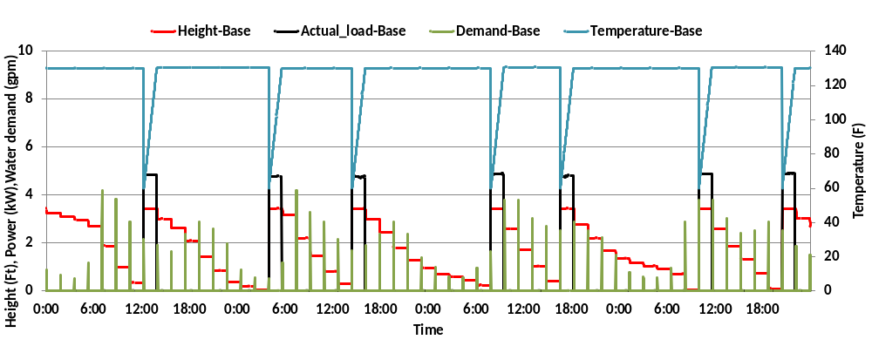
Waterheater (physical model)
Simulation Results – Two-node Model

Slide 24
Waterheater (physical model)
class waterheater {
double tank_volume[gal];
double tank_UA[Btu/h];
double tank_diameter[ft];
double water_demand[gpm];
double heating_element_capacity[kW];
double inlet_water_temperature[degF];
enumeration heat_mode; //GASHEAT, ELECTRIC
enumeration location; //GARAGE, INSIDE
double tank_setpoint[degF];
double thermostat_deadband[degF];
double temperature[degF];
double height[ft];
double actual_load[kW];
}

Slide 25
Dishwasher
object dishwasher {
double energy_baseline [kWh];
bool Heateddry_option_check;//// true or false
double control_power [W];
double motor_power [W];
double dishwasher_coil_power_1 [W];
double dishwasher_coil_power_2 [W];
double dishwasher_coil_power_3 [W];
double daily_dishwasher_demand DISHWASHER;
double queue;
double queue_min;
double queue_max;
};

Slide 26
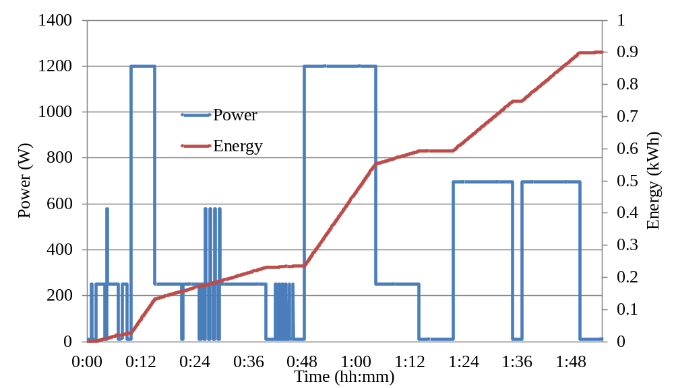
Dishwasher
Variables | Values
energy_baseline | 0.9kWh
Heateddry_option_check | true
control_power | 10W
motor_power | 250W
dishwasher_coil_power_1 | 580W
Variables | Values
dishwasher_coil_power_2 | 695W
dishwasher_coil_power_3 | 950W
queue | 1
queue_min | 0
queue_max | 2

Slide 27
Dryer
object dryer {
double energy_baseline [kWh];
double controls_power [W];
double motor_power [W];
double dryer_coil_power [W];
double daily_dryer_demand DRYER;
double queue;
double queue_min;
double queue_max;
};

Slide 28
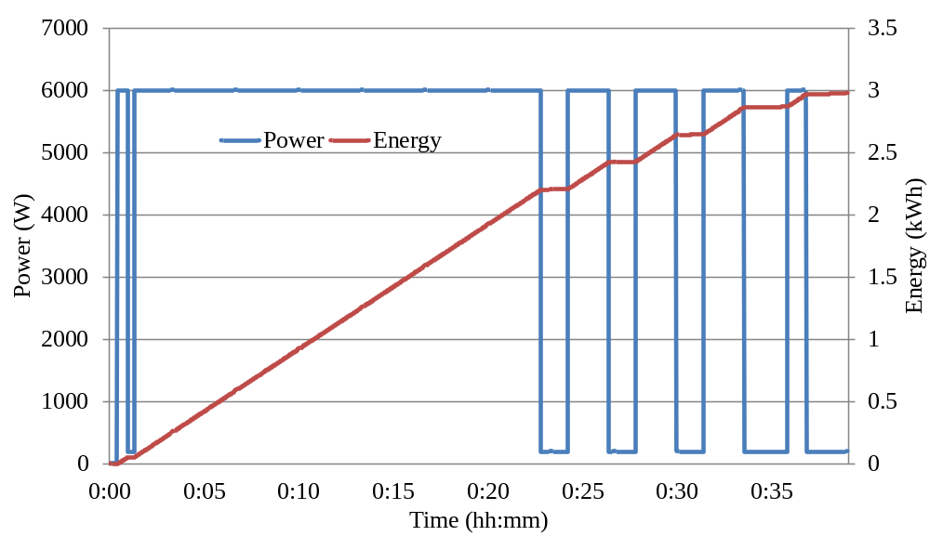
Dryer
Variables | Values
energy_baseline | 3.0kWh
controls_power | 10W
motor_power | 200W
dryer_coil_power | 5800W
queue | 0.8
queue_min | 0
queue_max | 2

Slide 29
Range
object range {
//Oven
double oven_volume [gal];
double heating_element_capacity [Kw];
double oven_setpoint [degF];
double temperature [degF];
double thermostat_deadband [degF];
enumeration location; //GARAGE, INSIDE
double oven_UA [Btu.h/degF];
double food_density [lb/cf] ;
double specificheat_food [Btu/lb.degF];
double time_oven_setting [s];
double queue_oven;
double demand_oven RANGE;
double oven_demand;

Slide 30
Range
//cooktop
double cooktop_energy_baseline [kWh]; double cooktop_coil_setting_[kW];
double cooktop_coil_setting_2 [kW];
double cooktop_coil_setting_3 [kW]; double cooktop_interval_setting_1 [s];
double cooktop_interval_setting_2 [s];
double cooktop_interval_setting_3 [s];
double time_cooktop_setting [s];
double demand_cooktop RANGE;
double queue_cooktop;
double queue_min;
double queue_max;
};

Slide 31
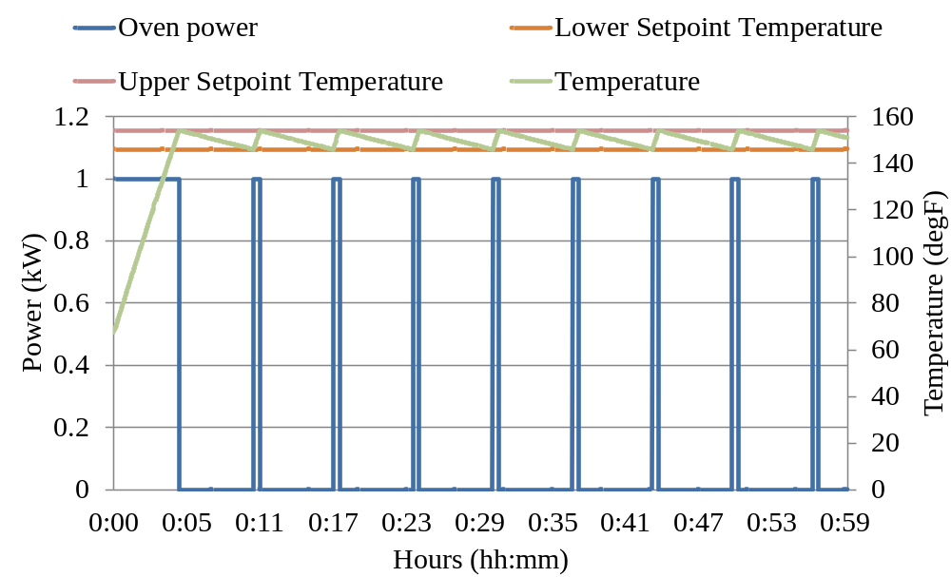
Range (Oven)
Variables | Values
oven_volume | 5
heating_element_capacity | 1kW
oven_setpoint | 150degF
temperature | 70degF
thermostat_deadban | 8degF
location | INSIDE
Variables | Values
oven_UA | 2.9
food_density | 5
specificheat_food | 1
time_oven_setting | 3600s
queue_oven | 0.85

Slide 32
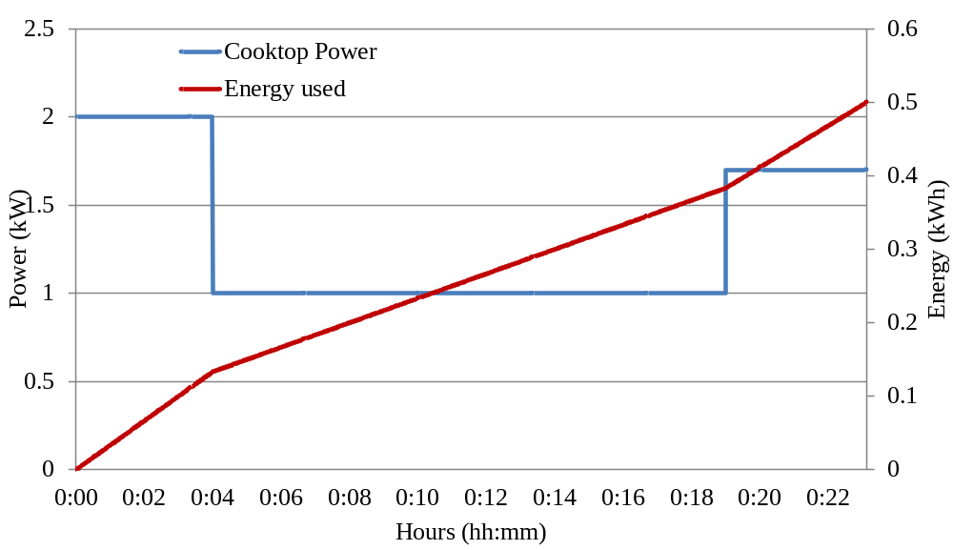
Range (Cook top)
Variables | Values
cooktop_energy_baseline | 0.5 kWh
cooktop_coil_setting_1 | 2kW
cooktop_coil_setting_2 | 1.0kW
cooktop_coil_setting_3 | 1.7kW
cooktop_interval_setting_1 | 240s
Variables | Values
cooktop_interval_setting_2 | 900s
cooktop_interval_setting_3 | 120s
Queue_cooktop | 0.99
queue_min | 0
queue_max | 2

Slide 33
Refrigerator
object refrigerator {
double door_opening_criterion REFRIGERATOR;// ELCAP
double daily_door_opening;
enumeration state; // COMPRESSSOR_OFF_NORMAL
double energy_used [kWh];
enumeration defrost_criterion;// DOOR_OPENINGS
double delay_defrost_time [s];
double door_opening_criterion;
};

Slide 34
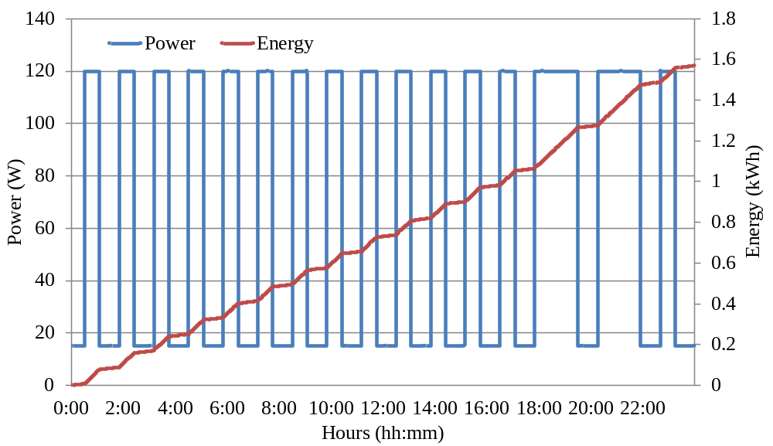
Refrigerator
Variables | Values
door_opening_criterion | REFRIGERATOR
daily_door_opening | 20
state | COMPRESSSOR_OFF_NORMAL
energy_used | 13.5kWh
defrost_criterion | DOOR_OPENINGS
delay_defrost_time | 600s
door_opening_criterion | 24

Slide 35
Clotheswasher
object clotheswasher {
double queue;
double demand CLOTHESWASHER;//ELCAP
enumeration state// STOPPED
double queue_min;
double queue_max;
};

Slide 36
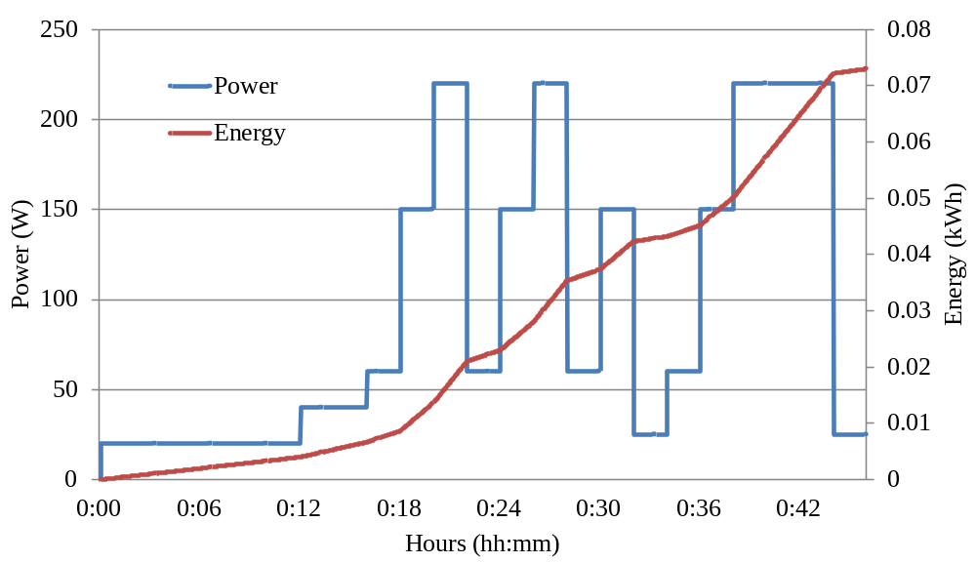
Clothes washer
Variables | Values
queue | 1.7
state | STOPPED
queue_min | 0
queue_max | 2

Slide 37
Lights
class lights {
// In addition to residential enduse variables
enumeration type; //HID, SSL, CFL, FLUORESCENT, //INCANDESCENT
enumeration placement; //OUTDOOR, INDOOR
double installed_power[kW];
double circuit_split; // -1=100% on 1 … +1=100% on 2
double demand[unit]; // fraction that is on
double power_density[W/sf];
complex actual_power[kVA]; //actual power consumption
}

Slide 38
Plugs
class plugload {
// In addition to residential enduse variables
double circuit_split;
double demand[unit];
double installed_power[kW];
complex actual_power[kVA];
}

Slide 39
Occupants
class occupantload {
int32 number_of_occupants;
double occupancy_fraction[unit];
double heatgain_per_person[Btu/h];
}

Slide 40
Microwave
class microwave {
//Note: This object is not fully operational.
double installed_power[kW];
double standby_power[kW];
double circuit_split;
double cycle_length[s];
enumeration state; //ON, OFF
double runtime[s];
double state_time[s];
}

Slide 41
Freezer
class freezer {
//Note: This object is not fully operational.
double size[cf];
double rated_capacity[Btu/h];
double temperature[degF];
double UA[Btu.h/degF];
double deadband[degF];
double setpoint[degF];
}

Slide 42
Zipload
class ZIPload {
// In addition to residential enduse variables
double heat_fraction;
double base_power[kW];
double power_pf;
double current_pf;
double impedance_pf;
double breaker_val[A];
double is_240; //true or false
complex actual_power[kVA];
}
Generic load model that allows adjustment of all power factors and zip fractions.
Only uses enduse structure (no state model).

Slide 43
Exercises
Create a house object with all end-uses implemented and plot the power output for a winter week and a summer week.
Using the same model, plot the indoor temperature for a winter week and a summer week.
Modify the same house to only contain the HVAC and a zipload object that is driven by a schedule transform (no enduses). Record the power output over time. Modify the ZIP fractions, and observe the difference.
Create a house with two water heaters. Have one waterheater be a physical model, while the other driven by a load_shape. Compare power output from the water heaters. Hint: use a schedule transform for the first and loadshape myshape & water_demand this.myshape for the second example.

